Slide 1
Prepared By Dr.SREEJA.S H.O.D, Dept of Pharmacy
PHARMACEUTICAL
INSTRUMENTS

Slide 2
FOR PREPARATION OF HOMOEOPATHIC MEDICINES
Mortar, Pestle, Chopping board
and knife, Leather pad, Percolator,
Presses, Sieves.
Balances; Measuring cylinder;
Graduated conical glass; Measuring tile;
Funnel; Volumetric flask; Official medicine
dropper; Beaker; Spatula and spoon.
FOR WEIGHING, MEASURING & STORAGE

Slide 3
Those used in heating
Burner; Water bath; Sand bath;
Wire gauze and tripod stand;
Hot air oven; Thermometer
Those used in laboratory procedures
Crucible; Evaporating dish; Distillator;
Condenser; Retort still; Desiccator;
Tray dryer; Pycnometer; Hydrometer;
Alcoholometer.

Slide 4
MORTAR AND PESTLE
The apparatus used in trituration is the
mortar and the pestle, aided by the spatula.
Mortars are available in diverse sizes, shapes
and material, but are usually hemispherical
in shape and made of agate, iron
or steel, porcelain, glass
and wedgewood.

Slide 5
Porcelain mortar - for trituration of
powders. Inside of mortar and face of
pestle should be ground and unglazed
for producing friction.
Glass mortar - for mercurial preparations,
ointments.
Agate mortars - for hard substances
Iron or steel mortar - for pulverizing hard
substances, e.g. seeds of Nux vomica

Slide 6
Pestle of porcelain, accompanying the mortar
has a wooden handle, which is fixed into the
head of the pestle that is made of the same
material as that of the mortar. The fixing has
to be properly cemented, as the handle tends
to separate from the head due to repeated use.
Mortar and pestle should not be interchanged.
The efficiency of trituration depends
on the maximum contact between the
surfaces of the head of the pestle and the
interior of the mortar.

Slide 7
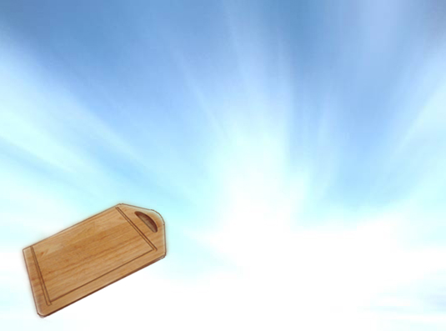
CHOPPING BOARD AND KNIFE
Chopping boards should be made of sound,
well-seasoned maple, and maybe circular or
oval shaped. Marble or glazed porcelain slabs
may also be utilized. It is used as a base for
cutting, slicing or chopping fresh medicinal
plants and their parts.
Chopping knives should
be made of good steel, well
polished and free from rust,
as rust decomposes many
vegetable juices at once.

Slide 8
LEATHER PAD
During succussion, vial should be
struck against a hard and elastic
object, so that strike of the vial ends
in a jerk.
This is achieved by leather pad, having
a belt from the edge of the longer side
to secure the pad on the palm.

Slide 9
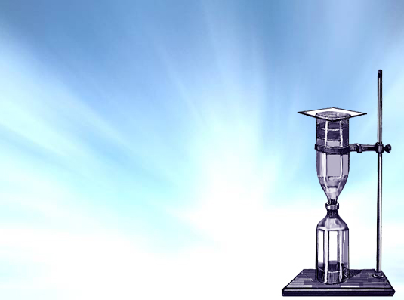
PERCOLATOR
The utensil in which drug is packed for
percolation is a percolator.
A percolating apparatus consists of the
percolator and the receiver. The
percolator has a body, which
contains the packing and a lower
narrow portion called the neck that
may be connected to the receiver.
The saturated solution emerging from
percolator is called percolate and is
collected in the receiving bottle.

Slide 10
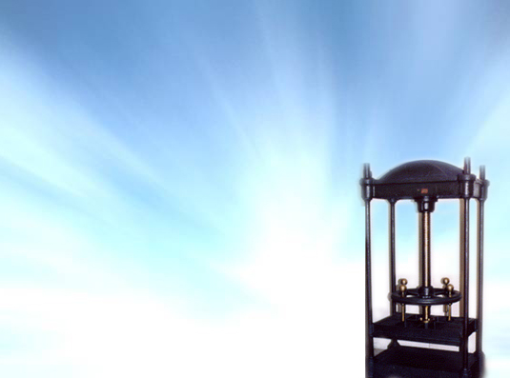
PRESSES
Presses consist of two parts between which
the substance is placed and which approach
each other by means of lever or screw. These
can be taken apart and thoroughly cleansed.
The mass to be expressed is
enclosed in a bag of stout cloth
(press cloth) before placing it in
the press.
Such a press cloth can be used
directly for expression by
forcible straining.

Slide 11
WOODEN PRESS

Slide 12
ROLLER PRESS

Slide 13
HYDROULIC PRESS

Slide 14
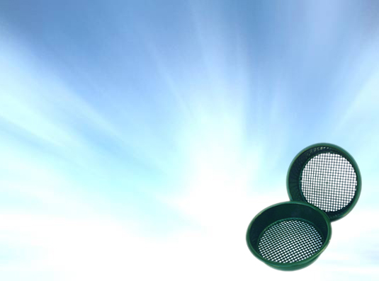
SIEVES
These are vessels with meshed or
perforated bottom for separating fine
powders from coarser substances in
the mixture.
Screens most commonly
used are woven wire sieves,
bolting cloth, closely spaced
bars and punched plates.

Slide 15
According to HPI, the sieves are
specified as sieve numbers 6, 8, 10,
22, 25, 30, 36, 44, 60, 85, 100 and 200.
The sieves that are used
today are made up of silk,
hair or stainless steel wire.

Slide 16
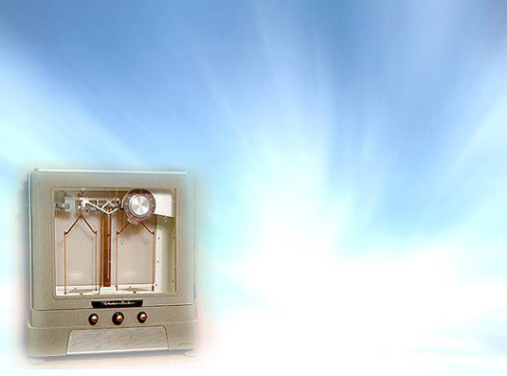
BALANCES
For systematic consideration, pharmaceutical
balances may be classified as follows:
Single beam,
equal arm balances
Single beam,
unequal arm balances
Double beam,
unequal arm balances
Compound lever balances
One arm balance

Slide 17
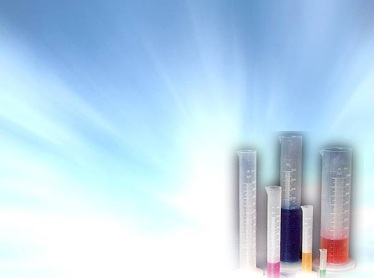
MEASURING CYLINDER
These are long, cylindrical shaped
calibrated glass containers used for
measuring volume or capacity of liquids.
Measuring glass cylinders
are available in different
capacities with different
least counts.

Slide 18
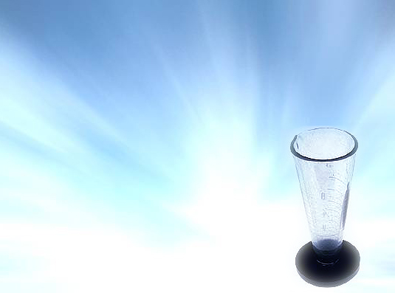
GRADUATED CONICAL GLASS
These are available in different capacities
as 10 ml, 50 ml, 100 ml, etc. These may
be made of glass or plastic.
Conical measures have this
advantage that it is easier to
fill without spilling the liquid
on the sides above required
level. It is also convenient to
rinse, clean and drain.

Slide 19
MEASURING TILE
The measuring tile or pill tile is generally
made of porcelain or glass, with the
painted graduations burnt in during the
process of glazing of the porcelain or
etched into the glass.
It is generally used for measurement of
globules and preparation of ointments.

Slide 20
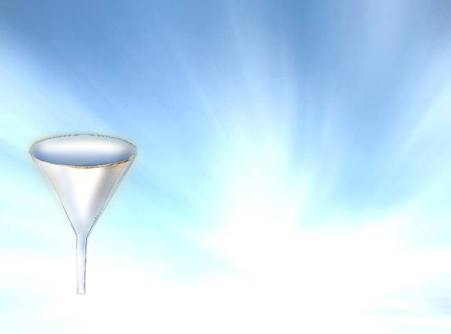
FUNNEL
Funnel is a conical shaped apparatus
intended to facilitate the pouring of liquids
into narrow-mouthed vessels.
They are chiefly used for
transfer of liquid, filtration
and sublimation. They are
widely used for supporting
filter media.
Funnels maybe made of glass,
polyethylene, metal, porcelain
or any other material that
serves the specific purpose.

Slide 21
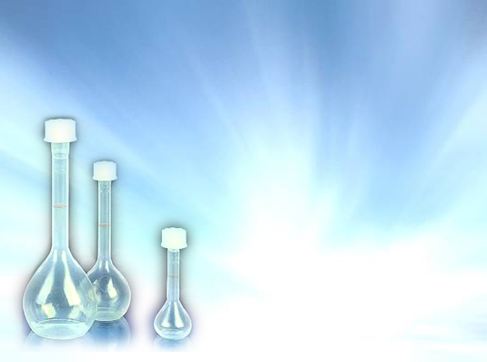
VOLUMETRIC FLASK
A volumetric flask is a flat-
bottomed glass container,
with a long narrow neck.
It is accompanied with a
stopper, which is usually
made of glass or plastic.
Flasks may be of different
capacities.
It is generally used for
preparation of reagents
and also for storing.

Slide 22
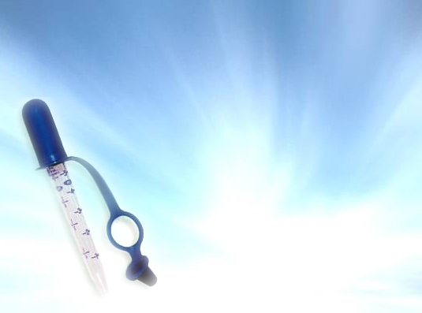
OFFICIAL MEDICINE DROPPER
The pharmacopoeial
medicine dropper is 3 mm
in external diameter at its
delivery end and when held
vertically delivers 20 drops
of water, the total weight of
which is between 0.9 g and
1.1 g at 25ºC.

Slide 23
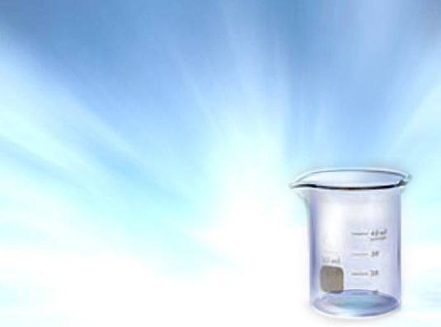
BEAKER
The mouth of the beaker is generally
circular, but some beakers may have a
spout or lip in the mouth of the beaker
for better drainage of the liquid.
It is usually made of glass.
These are available in
different sizes. It is used for
storage of liquids.

Slide 24
SPATULA AND SPOON
These are usually made of horn, bone,
ivory, porcelain, solid hard rubber and
stainless steel. Handle of spatula is
usually heavier than blade.
The object of spatula in
trituration is to scrape
triturated powder from
sides of mortar.

Slide 25
The spatula is also used for handling and transfer of powders and in preparation of semi-solid external applications like ointments.
Spoon is used to transfer liquids.

Slide 26
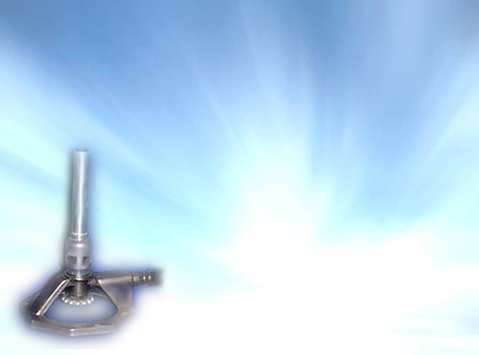
BURNER
For burning gas fuels, special devices are
required that allow the gas to burn without
danger. Such devices are called burners.
Bunsen burner :
A Bunsen burner is a device used in labs for production of heat and flame by burning gaseous fuel. The flame of the
Bunsen burner is superior to
the ordinary flame by reason
of its greater heat.

Slide 27
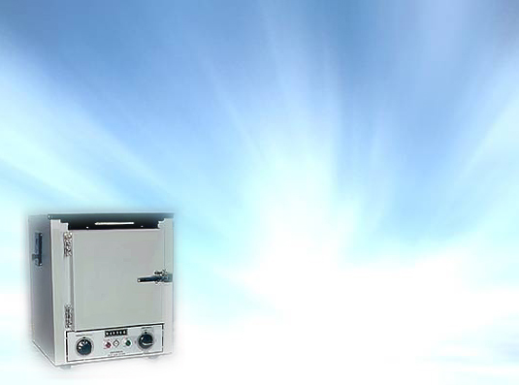
HOT AIR OVEN
The air is ignited in a closed chamber known
as hot air oven. It is a small chamber, made
of aluminium or stainless steel.
The oven is heated electrically.
The materials are heated by
keeping them on the shelves
of the oven.
It is used for the evaporation
of the moisture of vegetable
drugs or other raw materials.

Slide 28
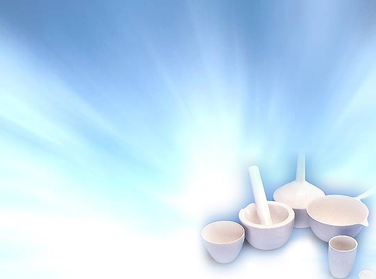
CRUCIBLE
Crucibles are utensils of various sizes,
shapes and materials.
Porcelain crucibles are the most
popular of all forms of crucibles.
It is used for drying substances in
small amounts at a high
temperature.
For drying at a very high
temperature, crucible
made of silica is used.

Slide 29
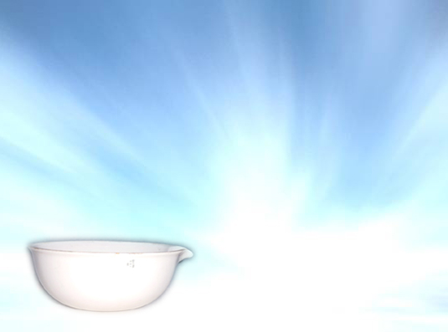
EVAPORATING DISH
The simplest form of natural circulation
evaporator is the evaporating dish.
It consists of a hemispherical or shallow
pan constructed from a suitable material
such as porcelain, glass, silica ware,
copper or stainless steel.
It is used for evaporation of liquids.

Slide 30
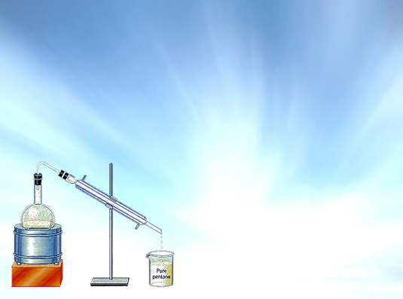
DISTILLATOR
For simple distillation in the lab, a distillation
flask with side arm sloping downwards is used.
When large quantities of water are to be condensed,
a spray or jet condenser is frequently used, which brings the vapor in direct contact with cooling water.

Slide 31
The flask should be of such a size that it is one-half to two-thirds full of the liquid to be distilled.
When large quantities of water are to be
condensed, a spray or jet condenser is
frequently used, which brings the vapor
in direct contact with cooling water.

Slide 32
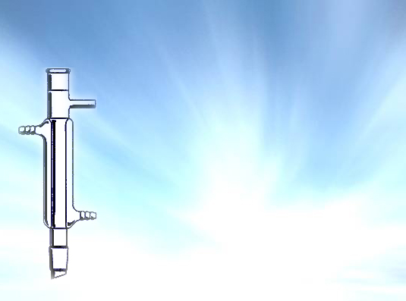
CONDENSER
A condenser is a heat exchanger.
Liebig Condenser :
This consists of a long glass
tube that is connected with
the boiler, be it a retort or
flask, thus affording passage to
the vapor arising from the boiler.
Surrounding this glass tube is a
second tube, usually made of
glass, through which passes a
stream of cold water.

Slide 33
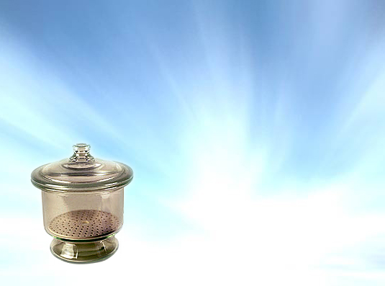
DESSICATOR
It is used for removing moisture or dehydration
of substances at moderate temperature.
It is an airtight thick walled hard glass vessel
provided with a glass lid fitting perfectly
on the upper rim of the desiccator.
The air inside the desiccator
is always kept dry by placing
some drying agent like fused
calcium chloride or conc
sulphuric acid.

Slide 34
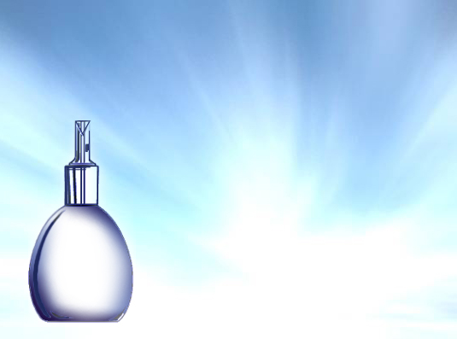
PYCNOMETER
Pycnometer or a specific
gravity bottle is a flat-bottomed
bulb-like glass bottle with a
long tapering neck. A well-
ground solid glass stopper with
a narrow bore fits the neck.
A specific gravity bottle should
always be held by the neck and
never by the bulb.
It is used in the determination
of specific gravity.

Slide 35
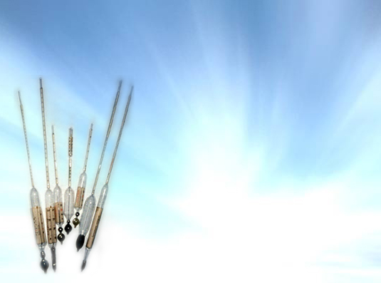
ALCOHOLMETER
Used for estimating the strength of alcohol.
Markings are in actual percentage of alcohol.
The alcoholometer is dipped
in a sufficient quantity of
alcohol and allowed to float.
The graduations on the
alcoholometer are such that
when alcoholometer is at
rest, the lower meniscus
coincides with percentage
content of alcohol in the
given liquid.

Slide 36
CLEANSING OF UTENSILS
Utensils should be washed when used for
first time and again washed immediately
after use.
Hydrochloric acid, nitric acid, or a solution
of potassium bichromate in sulphuric acid
may be beneficial to remove dirt and other
stains.
Ordinary cleaning is done with soda and
hot water. To remove greasy and oily materials,
methylated spirit, ether, chloroform is used.

Slide 37
MORTAR AND PESTLE
After completion of trituration, mortar,
pestle and spatula are to be several times
scalded with boiling water, being after
every scalding wiped quite dry and clean.
If further precaution is used of exposing
mortar, pestle and spatula to a heat
approaching red heat, this will dissipate
every thought that any least rest of the
medicine last triturated can cling to them.

